Slide 1





Technical Dependency Challenges in
Large-scale Agile Software Development
Nelson Sekitoleko¹
Felix Evbota¹
Eric Knauss¹
Anna Sandberg²
Michel Chaudron¹
Helena H. Olsson³
¹Chalmers|University of Gothenburg
²Ericsson AB
³Malmö University

Slide 2
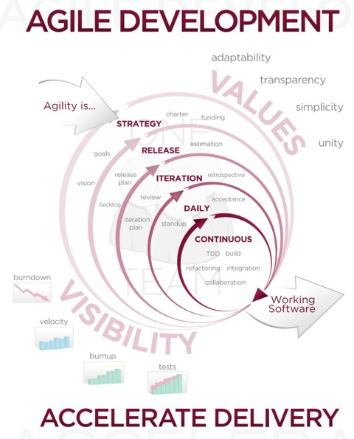

Research Aim
Primary definition of Agile
http://www.portlandwebworks.com/

Slide 3


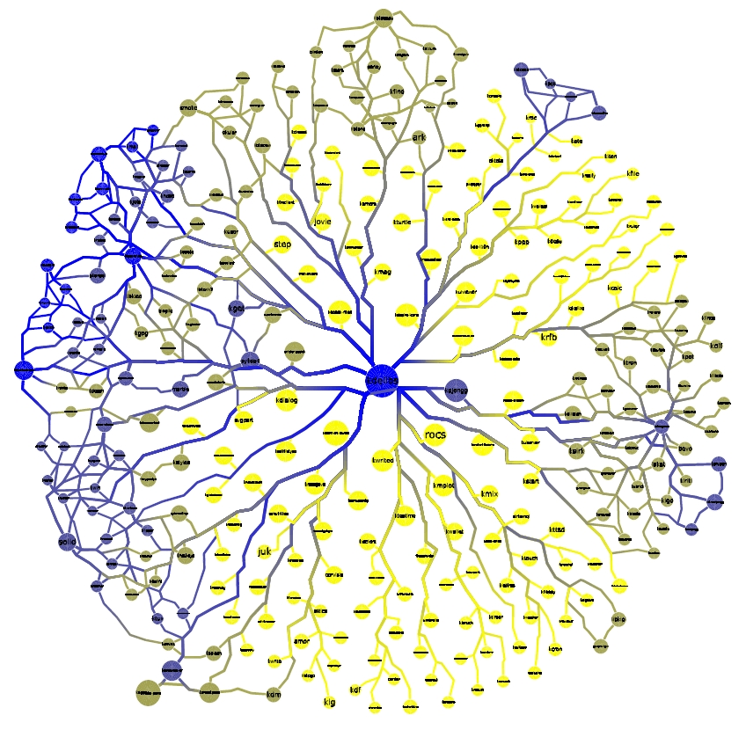
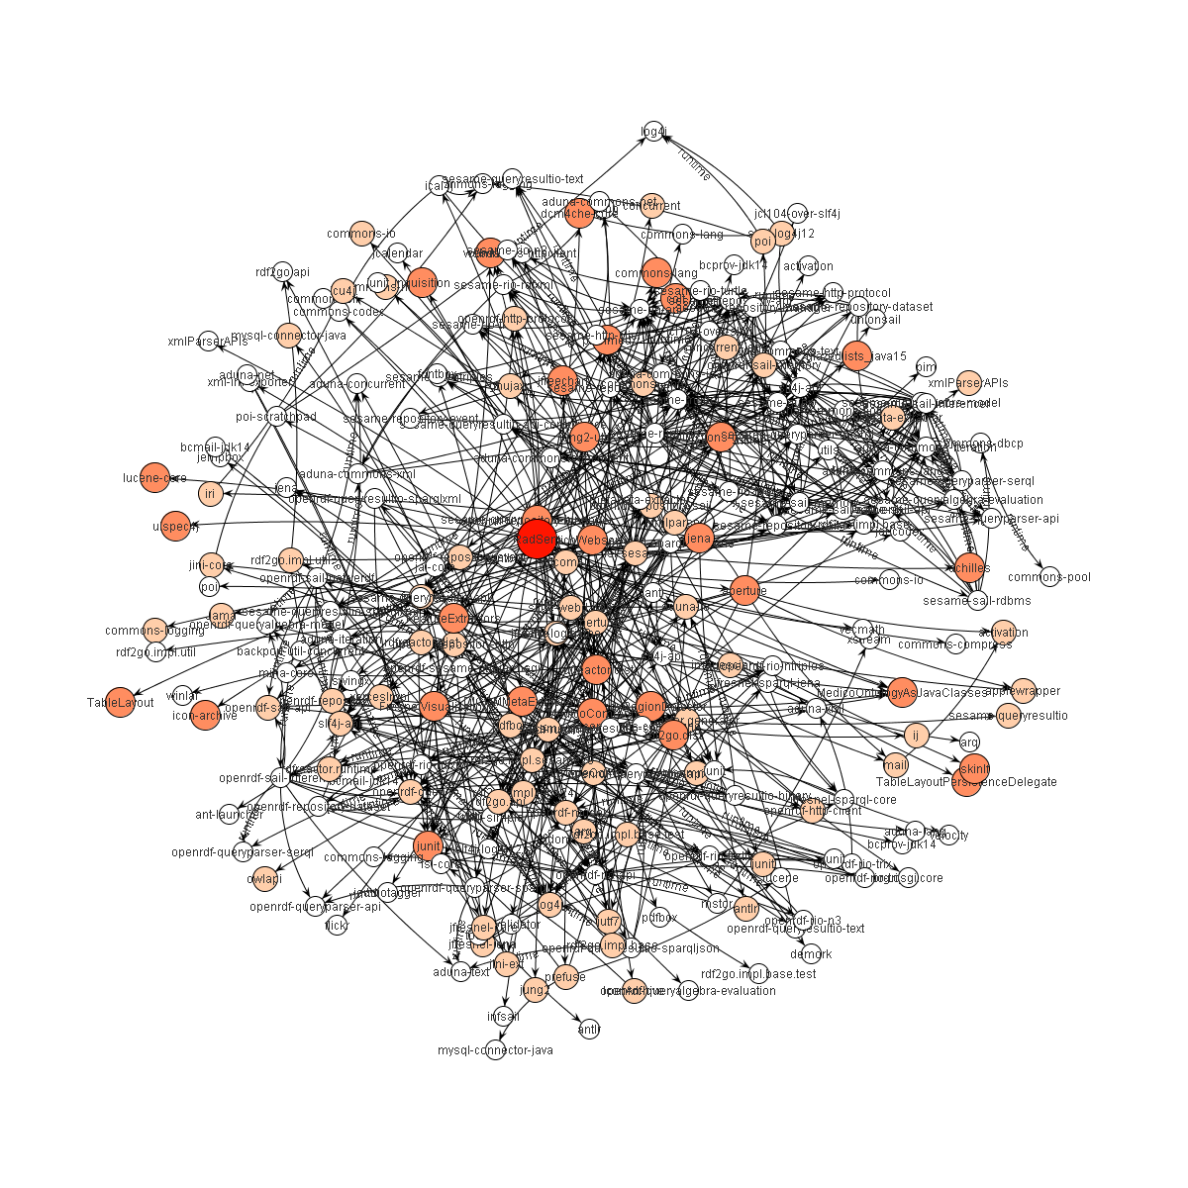
Attempt to scale Agile
Effective Communication & Cordination
Teams at the Project start
Teams a few weeks later
Planned technical dependencies
Unplanned Technical dependencies
http://reelwebdesign.com/
https://blog.surfnet.nl/?p=2784

Slide 4
Research Questions
RQ1: What are the challenges associated with technical dependencies between teams in a large-scale agile software development?
RQ2: What affects the likelihood of a challenge to occur?

Slide 5
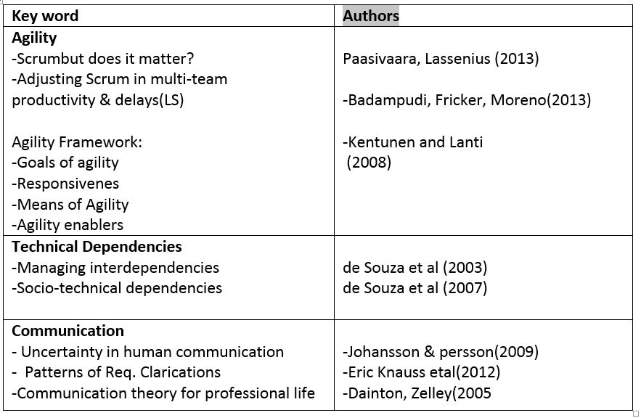
Related Work

Slide 6

Research Method
3 Months Case study research at
-9 semi-structured interviews
-Sample selected based on insider knowldge about skills & exprience from Population size/Project of 300 Software Engineers
-Sample has average working exprience of 10 years & 3 years with agile
-Interview questions focused on planned and unplanned technical dependencies by XFT
Interviews Roles
P1 Software designer/developer
P2 Software designer and scrum master
P3 Function tester
P4 Software designer
P5 Software designer and scrum master
P6 Scrum master and architect
P7 Software designer and scrum master
P8 Function tester
P9 System manager, scrum master
Follow up Survey 3 months later
To confirm our finding
Survey measured the interviewee’s agreement with our findings and recommendations

Slide 7

Research Method
Thematic Data Analysis Approach
(Braun and Clark (2006)
http://orastories.com/critical-thinking/

Slide 8
Analysis and Interpretation
RQ 1: Technical Dependency Challenges in Large-Scale Agile
C1. Planning challenge
C2.Teams backlog priority challenge
C3. Knowledge sharing
C4. Code quality challenge
C5. Integration challenge

Slide 9

C1. Planning challenge
“[Managers] do not plan and allocate tasks to teams in an appropriate way because they do not know much about the code and do not involve in the actual coding."
http://www.eurocharts.co.uk/project_planning_boards.htm

Slide 10

C2.Teams backlog priority challenge
“”\[...] constant changing of priorities makes our burn-down charts look
bad.“”
http://colearningbe.files.wordpress.com/2013/03/backlog.jpg

Slide 11

C3. Attitude and knowledge sharing challenge
-Experienced personnel are too busy to be approached
--Protectiveness due to fear of providing support
-Bad teachers
-Over specialization
-Lack of communicativeness
http:// http://blog.adminitrack.com/

Slide 12
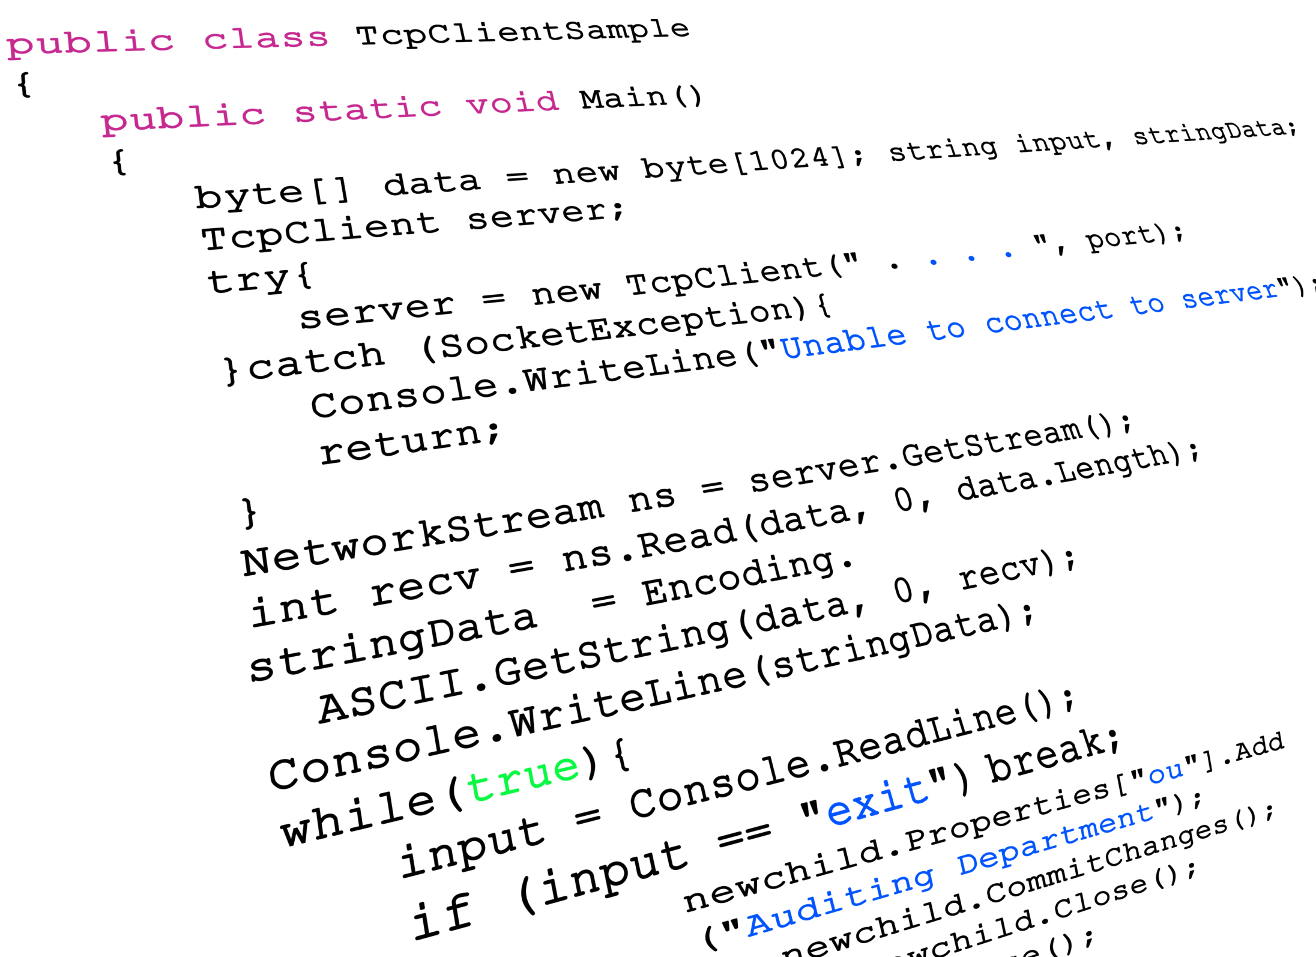
C4. Code quality challenge
“Too many people involved in the same code make changes in the code which can end up as conflicts in other teams”
“Such changes make it difficult to maintain a stable version of code, hence reducing code quality and creating more technical dependencies."
http://dandev91.wordpress.com/

Slide 13

C5. Intergration challenge
-Incompatible components cause merge conflicts, teams re-plan or re-develop leading to late deliveries.
http://dandev91.wordpress.com/

Slide 14
RQ 2: What affects the likelihood of a challenge to occur?
A. Relationships and interdependencies.
Domino effect/Viscous circle
-Challenges interact with one another to form a domino effect which leads to the technical dependency loop.
-Suboptimal planning causes Technical Dependencies which later surface as task prioritization challenges …….. and loop continues for all other challenges
-Circular relationships are bidirectional
high
Mindset
Working Practice
Knowledge sharing
Planning
Task Prioritization
Communication challenges
Code quality
Technical Action
Integration
low
high
Technical challenges

Slide 15
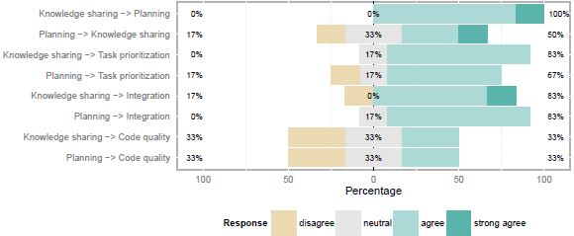
RQ 2: What affects the likelihood of a challenge to occur?
B. Understanding the nature of challenges.
Fig.3
-Planning and task prioritization are recognized as most challenging.
Fig.3 How the solution for planning, knowledge sharing positively impact other challenges?
-A solution for the knowledge sharing challenge would have a most positive impact on other challenges
-Code quality challenge is a bit detached from the vicious circle

Slide 16
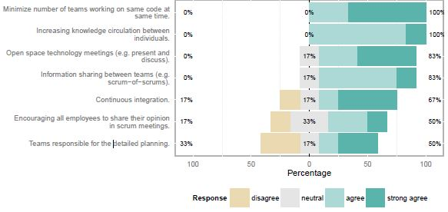
Recommendations to mitigate planning and knowledge sharing challenges
Fig.3
Fig.4. Agreement of participants with recommendations

Slide 17
Conclusion
If an organization struggles with one challenge, it is likely that the other challenges become problematic as well.
This situation can have a significant impact on process and product quality
Mitigating one of the challenges can have a positive impact on the other challenges and ultimately promises to break the vicious circle
Organizations should focus on mitigating the knowledge sharing and planning challenges to re-establish effective communication across teams so as to achieve the benefits of large-scale agility.

Slide 18


